Slide 1
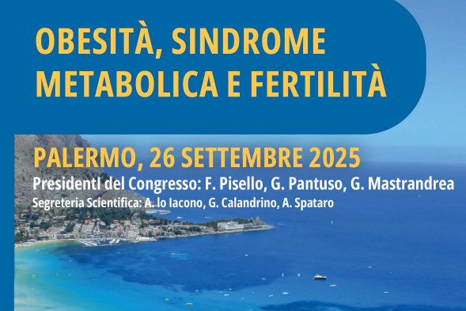


Sindrome metabolica: implicazioni endocrinologiche e
metaboliche sulla fertilità
Stefano Radellini
UOC Malattie Endocrine, del Ricambio e della Nutrizione
Policlinico P. Giaccone Palermo
Dipartimento di Promozione della Salute, Materno-Infantile, Medicina Interna e Specialistica di Eccellenza «G. D’Alessandro» Università di Palermo

Slide 2
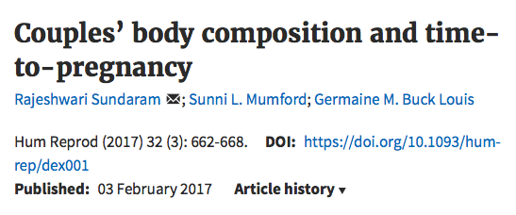
501 couples trying for pregnancy and recruited from 16 counties in Michigan and Texas between 2005 and 2009. Couples were followed daily for up to a year of trying or until a hCG pregnancy.
27% of women and 41% of men had BMI ≥30 kg/m2.
Fecundability was reduced by 23-36% in couples in which the woman’s waist circumference was >88.6 cm compared with those in which women had a smaller waist circumference (< 80 cm) regardless of the men’s waist circumference.
In couples in which the man had a larger waist circumference (94-101.6 cm) and the woman had a greater waist-to-height ratio, a significant reduction in fecundability (50%) was found compared with couples with smaller waist circumferences (adjusted fecundability OR = 0.5; 95% CI, 0.27-0.94).

Slide 3
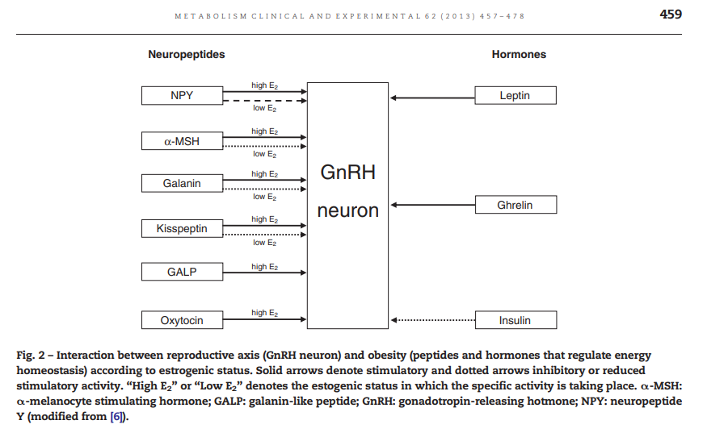

Slide 4
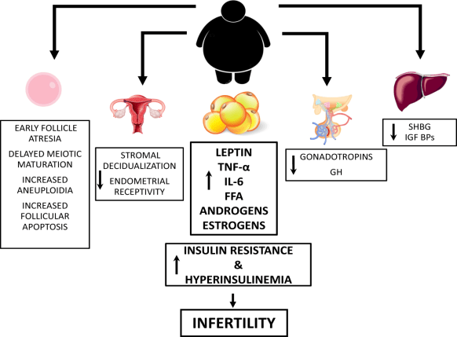
Female infertility: which role for obesity?
4
Each BMI unit > 29 reduces the chance of achieving a pregnancy within 12 months by about 4%
At BMI of 40 the likelihood of getting pregnant is 43% lower compared to normal weight because the quality of the eggs is reduced
Gambineri A et al. Int J Obes Suppl 2019; 9(1) :65-72; Jan Willem et al Human Reproduction Vol.23, No.2 pp. 324–328, 2008.

Slide 5
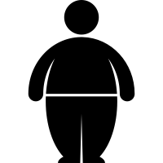
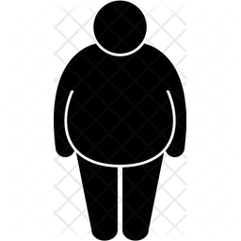
5
BMI ≥ 27 kg/m²
50% of PCOS women are
Overweigh or Obese ¹
^{Overweight}
^{+ ≥ 1 comorbidities}
[such as dysglycaemia (prediabetes or T2D), hypertension, dyslipidaemia or OSAS]
A common cause of anovulatory infertility:
~ 40% of women with PCOS are infertile²
^{es. h: 1.61 m, w: 70 kg}
BMI ≥ 30 kg/m²
^{Obesity}
In those with PCOS and infertility, ~ 90% are overweight²
^{es. h: 1.61 m, w: 78 kg}
T2D, type 2 diabetes; OSAS, obstructive sleep apnoea.
1. Gambineri, A. et al. Int J Obes 2002; 26, 883–896. 2. Teede et al. BMC Med 2010; 8: 41

Slide 6
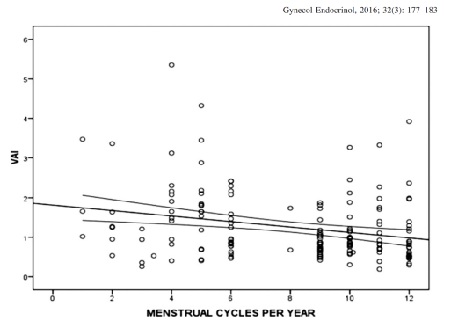
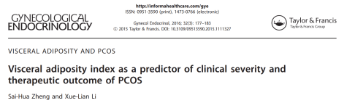
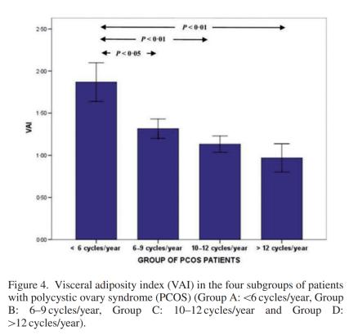
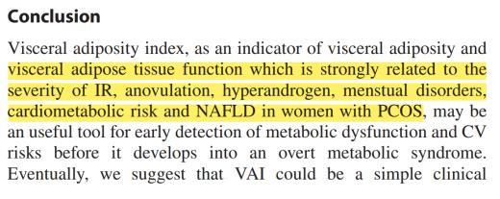

Slide 7
Risk of ovulatory infertility by BMI
7
Greater BMI at age 18 was a predictor of ovulatory infertility in women with and without a diagnosis of PCOS
2.7
Multivariate relative risk for infertility
1.7
Increasing risk of
ovulatory infertility
Data are from 2527 married nulliparous women with infertility, defined as an inability to become pregnant for at least 1 year due to ovulatory disorder.
BMI, body mass index; PCOS, polycystic ovary syndrome.
Rich-Edwards et al. Am J Obstet Gynecol 1994;171:171–7

Slide 8
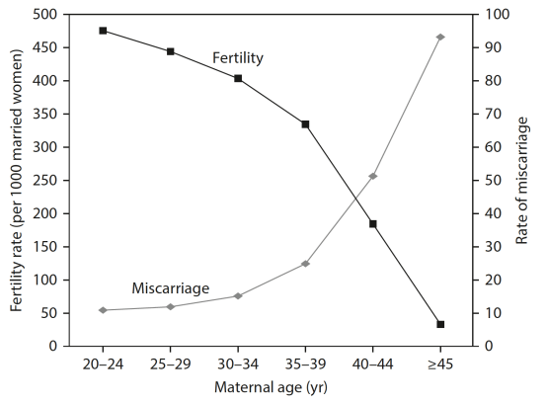



Fertility and miscarriage rates as a function of maternal age
8
BMI
Fertility
23%
Fertility
Fertility
55%
Age
Nwadndison M., Bewley S. Fettal and Maternal Medicine Review 2006, 17(3), 185-204.
Notes:
Stable up to the age of 30, with about 400 pregnancies for every 1,000 women (40%) not using contraception for one calendar year.
30-35% di gravidanze spontanee dai 35 anni
< 20 di gravidanze spontanee dai 40 anni

Slide 9

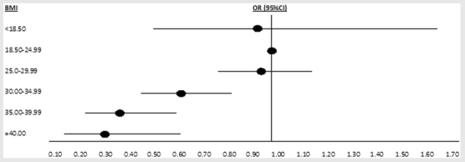
9
Live birth rate according to body mass index
Effect of BMI on live birth rates in 4,609 patients undergoing their first IVF cycle
Compared with normal BMI, the adjusted odds of live birth are:
37% in class I obesity
61% in class II obesity
68% in class III obesity
Moragianna VA, et al. Fertil Steril 2012;98:102-8

Slide 10
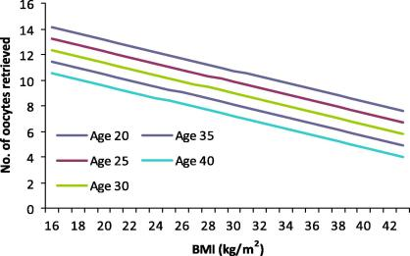
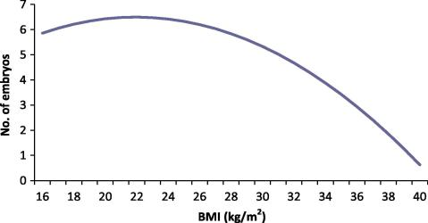
10
Fertility outcomes related to BMI
Negative association between the number of collected oocytes and BMI and women’s age
Fewer embryos in obese women
Pinborg A et al. Reprod Biomed Online 2011; 23 (4): 490- 499.
Notes:
Una donna di 30 anni con un BMI di 30 ha un numero di ovociti recuperate pari a quello di una donna di 40 anni normopeso.
Risultati:
Numero di cicli IVF (In Vitro Fertilization) con esito nullo significativamente più elevato nelle donne con obesità
Numero di gravidanze in corso inferiore tra le donne con obesità rispetto a quelle normopeso
Diminuzione dell’HCG sierico associata ad aumento del BMI
Una meta-analisi (1) ha rivelato che la riserva ovarica è significativamente ridotta nelle donne obese, che quindi consumano molto più rapidamente gli ovociti (la donna nasce con qualche milione di ovociti a livello ovarico, che si esaurisce fino all’insorgere della menopausa).
1. Nazanin. M. Is ovarian reserve associated with BMI and obesity in reproductive aged women? A meta-analysis. Menopause. 2018 25(9): 1046-1055

Slide 11
11
The impact of obesity on in vitro fertilisation outcomes
With overweight and obesity, ovarian stimulation periods are more likely to be lengthened
Compared with women with BMI 25 or below, those with higher BMI have
↓ 29%
↑ 33%
1. Reduced pregnancy rates
(OR 0.71,95% CI 0.62–0.81)
2. Have an increased risk of miscarriage
(OR 1.33, 95% CI 1.06–168)
3. Require higher doses of gonadotrophins for stimulation
(weighed mean differences 210.08, 95% CI 149.12–271.05)
Damian et al. Obesity and fertility Horm Mol Biol Clin Invest 2015; 24(1): 5–10.

Slide 12
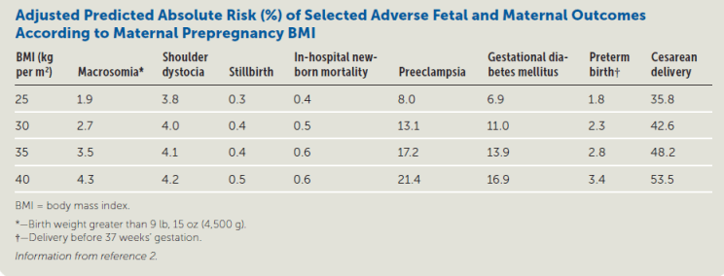
Obesity and pregnancy:
Risk (%) of Adverse Fetal and Maternal Outcomes
12
↑
↑
↑
↑
↑
↑
↑
↑
↑
↑
↑
↑
↑
↑
↑
↑
↑
↑
↑
↑
↑
↑
Schummers L et al. Obstet Gynecol. 2015; 125(1): 133-143.

Slide 13






Weight loss improves clinical features and long-term metabolic health in women
13
WL⁶
≥ 5%
Insulin levels lowered¹
Decreased insulin resistance²
Decreased androgen levels³
Menstrual cyclicity, ovulation and fertility improved²
Improved psychological outcome^{3,4}
Risk factors for CVD and T2D reduced⁵
Reduction of hirsutism, acne and skin affection³
CVD, cardiovascular disease; T2D, type to diabetes
1. Tolino et al. Eur J Obstet Gynecol Reprod Biol. 2005;119(1):87-93; 2. Panidis et al. Fertil Steril 2008; 89(4): 899-906; 3. Dokras et al. J Clin Endocrinol Metab 2016; 101(8): 2966-2974; 4. Thomson et al. Fertil Steril 2010; 94(5): 1812-1816;
5. Wild et al. J Clin Endocrinol Metab 2010; 95(5): 2038-2049; 6. Mariam A et al. Diabetes Obes Metab. 2021;23(12):2804-2813

Slide 14

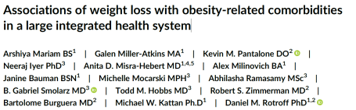
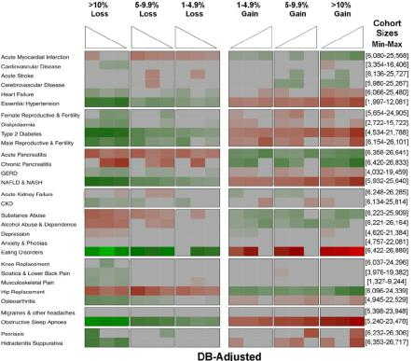
Weight loss benefit on female fertility
14
Significant decrease in obesity comorbidity – female infertility is possible, regardless of pre-existing disease, with a >5% reduction in weight
A reasonable goal with available lifestyle weight loss programmes and pharmacotherapy
Mariam A et al. Diabetes Obes Metab. 2021;23(12):2804-2813
Notes:
Aims: To determine the health outcomes associated with weight loss in individuals with obesity.
Materials and Methods: We conducted a case-control study using deidentified HER-derived information from 204 921 patients seen at the Cleveland Clinic between 2000 and 2018. Patients were aged ≥20 years with body mass index ≥30 kg/m2 and had ≥7 weight measurements, over ≥3 years. Thirty outcomes were investigated, including chronic and acute diseases, as well as psychological and metabolic disorders. Weight change was investigated 3, 5 and 10 years prior to an event.
The incidence of female reproductive and fertility effects were decreased with more substantial weight loss of 5% to 9.9% and >10% (P < 0.05).

Slide 15
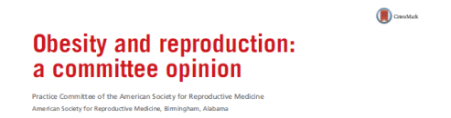
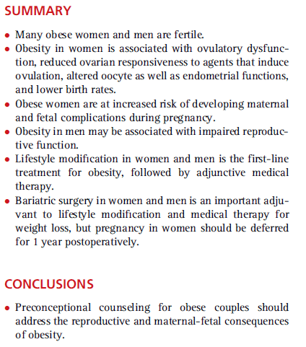
15
Is lifestyle modification enough?
Practice Committee of the American Society for Reproductive Medicine. Obesity and reproduction: a committee opinion. Fertil Steril. 2015;104(5):1116-26.

Slide 16
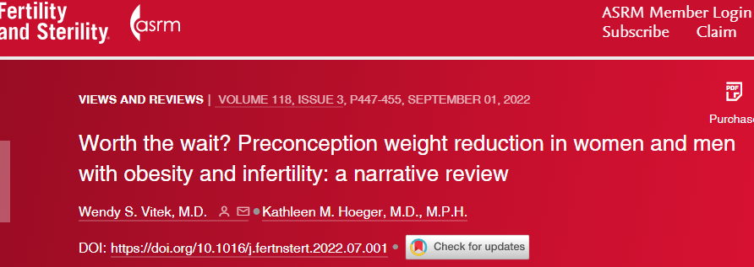
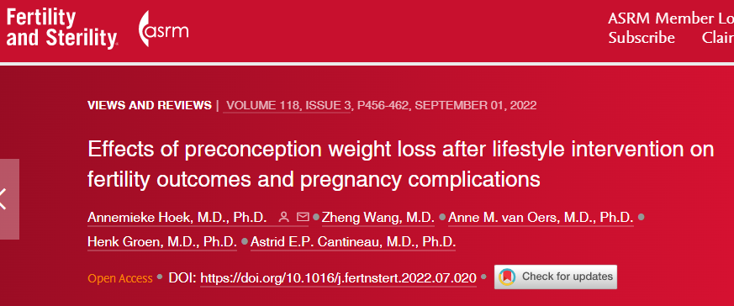
Notes:
Due lavori di Review e metanalisi comparsi in letteratura sono concordi nel concludere che la riduzione di peso nella donna infertile obesa aumenta significativamente la PR spontanea, tuttavia interventi a breve temine prima di tecniche di PMA sembra non migliorare outcomes di PMA

Slide 17
CONCLUSIONI
Le interazioni tra obesità e fertilità femminile sono molteplici, riguardano meccanismi sia centrali che periferici in parte ancora da chiarire
Sovrappeso e obesità influenzano negativamente la fertilità femminile e peggiorano gli outcomes di PMA
Indurre una perdita di peso di almeno il 5-10% contribuisce a migliorare lo stato di salute delle donne con sovrappeso e obesità e migliora la fertilità di donne con o senza PCOS
I GLP1ra, sono una categoria di farmaci promettenti nella cura della sub-fertilità delle donne sovrappeso-obese con o senza PCOS esercitando effetti diretti sull’asse gonadotropo, probabili effetti sull’ovaio e sull’endometrio (da chiarire)
Ulteriori studi prospettici controllati RTC e su più numerose casistiche di pazienti sono necessari per confermare questi dati preliminari

Slide 18
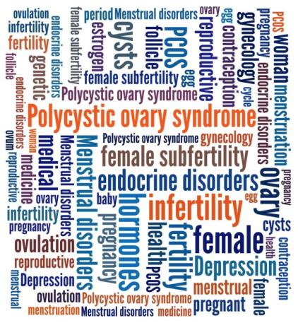
Weight Loss
18
GRAZIE PER L’ATTENZIONE
Do we finally have a treatment option to improve fertility outcomes?
^{Overweight}
^{Obesity}

